Slide 1
Weather Patterns, Rainfall Drivers, and Predictive Modelling in Australia
Samira Kapadiya
Dheeraj Vattikuti
Dhrumil Khalas
Northeastern University
Instructor: Dr. Sohom Mandal
February 14, 2026

Slide 2
Introduction
Rainfall is essential for agriculture, water management, infrastructure, and climate risk planning in Australia
Rainfall patterns vary across regions and require region-specific analysis
This study analyzes daily weather data from 44 Australian locations
Objective: Identify rainfall drivers, predict next-day rain, and group locations by climate patterns
Methods: Regression, logistic modelling, ROC analysis, PCA, and K-Means clustering
Findings support evidence-based planning for the Australian Government Department of Agriculture, Fisheries and Forestry

Slide 3
Dataset Overview
Dataset Information
Dataset: “Rain in Australia” from Kaggle
Original Size: 145,460 observations × 23 variables
After Cleaning: 119,590 observations × 16 variables
Variable Types (Final Dataset)
Numeric Variables: 12
Categorical (Factor): 2 (RainToday, RainTomorrow)
Other Variables: 2 (Date, Location)
Key Variables Used
Target Variables
Rainfall (mm): Continuous
RainTomorrow (Yes/No): Classification target
Main Predictors
Temperature: MinTemp, MaxTemp, Temp9am, Temp3pm
Wind: WindGustSpeed, WindSpeed9am, WindSpeed3pm
Humidity: Humidity9am, Humidity3pm
Pressure: Pressure9am, Pressure3pm
Data Cleaning Summary
Removed high-missing variables (Evaporation, Sunshine, Cloud variables, Wind direction)
Converted rain variables to factors
Removed rows with missing values
Final dataset contains 0 missing values

Slide 4
Research Questions
This presentation aims to provide data-driven insights into rainfall patterns, predictive forecasting, and regional climate segmentation across Australia for the Australian Government Department of Agriculture, Fisheries and Forestry to inform evidence-based planning and climate risk assessment.
Accordingly, the following research questions were formulated:
Which weather factors are most strongly linked to rainfall in Australia? (Multiple Linear Regression & Lasso Regression)
Can we predict whether it will rain tomorrow based on today’s weather conditions? (Logistic Regression)
Which locations in Australia have similar weather patterns? (K-Means Clustering)

Slide 5
Methods Overview
Data Preparation
Cleaned variables and handled missing values
Selected relevant weather predictors
Exploratory Analysis
Descriptive statistics and correlation analysis
Heatmap visualization
Modelling
Multiple Linear & Lasso Regression → Rainfall drivers
Logistic Regression → Rain Tomorrow prediction
ROC & AUC → Performance evaluation
Clustering
K-Means → Regional weather segmentation
Elbow, Silhouette & PCA → Cluster validation and visualization

Slide 6
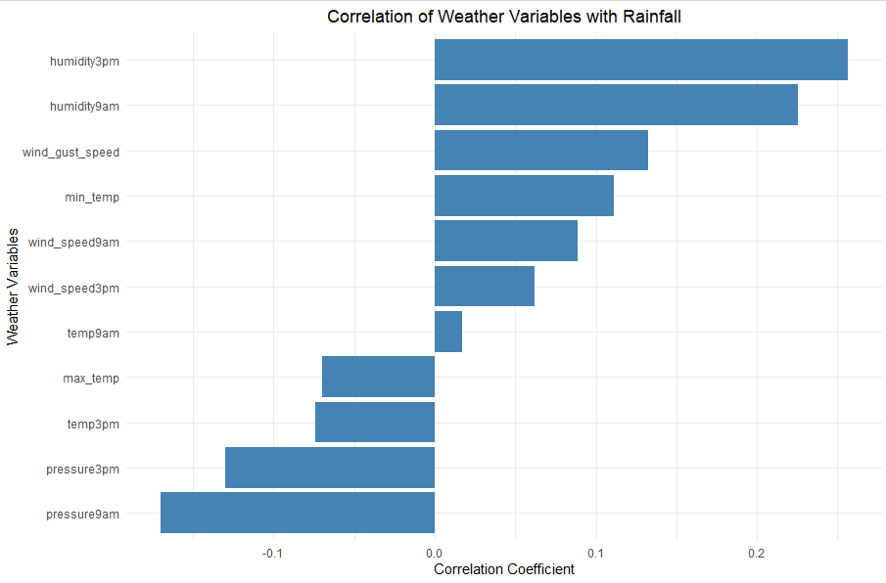
Research Question 1: Which weather factors are most strongly linked to rainfall in Australia?
Understanding the strongest drivers of rainfall helps the Department anticipate water availability, drought risk.
Strong Positive Signals
Humidity (9am & 3pm)
Wind Gust Speed
Strong Negative Signal
Pressure (9am & 3pm)
Weaker / Mixed Impact
Temperature variable
Takeaway
Rainfall is primarily linked to moisture levels and pressure systems.

Slide 7
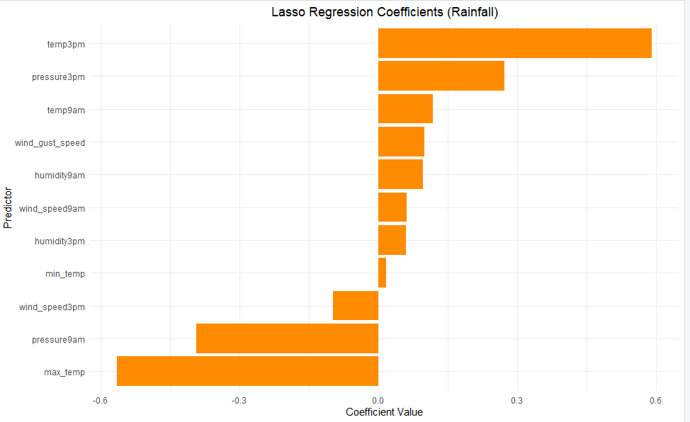
Research Question 1: Which weather factors are most strongly linked to rainfall in Australia?
Largest Positive Effects
Afternoon Temperature
Afternoon Pressure
Wind Gust Speed
Humidity
Largest Negative Effects
Maximum Temperature
Morning Pressure
Takeaway
Higher afternoon temperature and afternoon pressure increase rainfall, while higher maximum temperature and higher morning pressure reduce it.

Slide 8
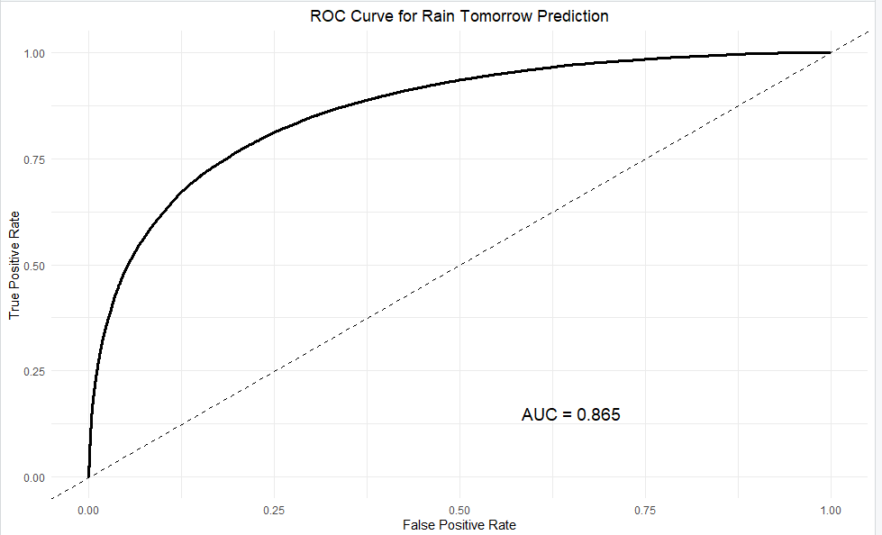
Research Question 2: Can we predict whether it will rain tomorrow based on today’s weather conditions?
Understanding the strongest drivers of rainfall helps the Department anticipate water availability, drought risk.
Model Performance
Overall Accuracy: 84.9%
Precision (Positive Predictive Value): 73.2%
Recall (Sensitivity): 49.2%
F1 Score: ≈ 58.8%
Specificity: 94.9%
ROC-AUC: 0.865 (Strong predictive ability)
Takeaway
The model has strong overall accuracy and clearly separates rain from no-rain days (AUC 0.865). It is very reliable at identifying dry days, but detects about half of actual rain events.

Slide 9
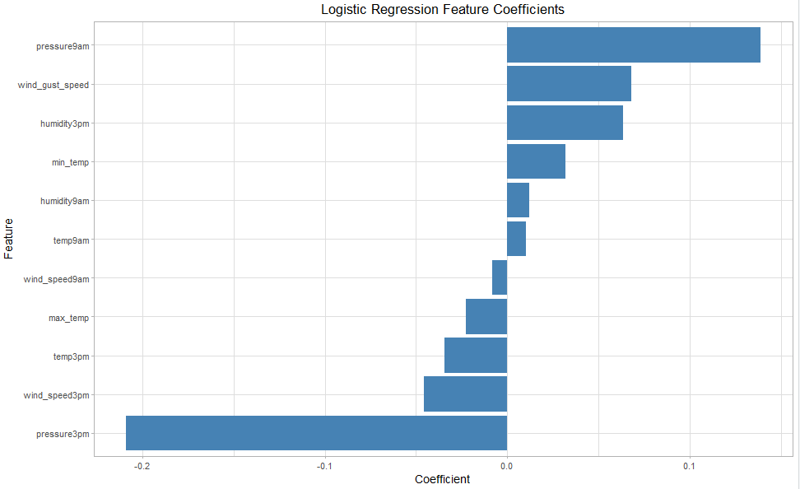
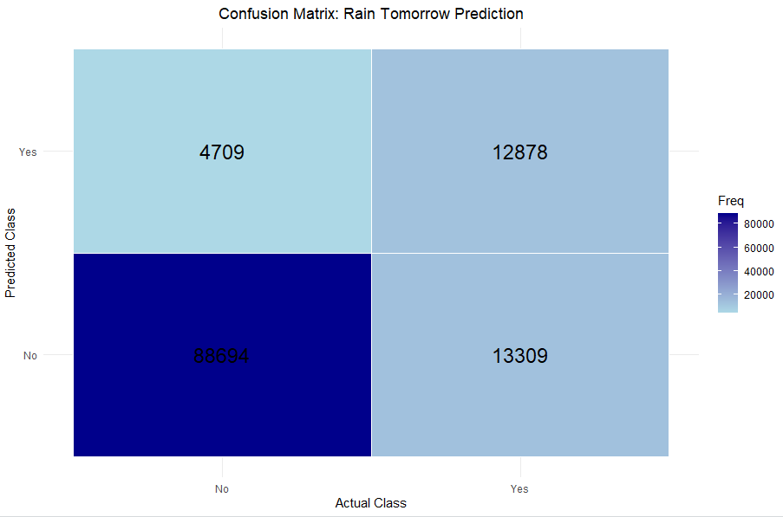
Research Question 2: Can we predict whether it will rain tomorrow based on today’s weather conditions?
Increase Rain Probability
Pressure (9am) → Strong Positive effect (0.139)
Wind Gust Speed → Strong positive effect (0.068)
Humidity (3pm) → Strong positive effect (0.063)
Minimum Temperature → Positive effect (0.032)
Decrease Rain Probability
Pressure (3pm) → Strong negative effect (-0.209)
Wind Speed (3pm) → Negative effect (-0.046)
Maximum Temperature → Negative effect (-0.023)
Confusion Matrix Summary
Correct No Rain Predictions → 88,694
Correct Rain Predictions → 12,878
Missed Rain Days (Predicted No, Actually Yes) → 13,309
False Alarms (Predicted Rain, Actually No) → 4,709
Takeaway
Pressure and wind patterns are the strongest signals of next-day rain. The model makes far more correct predictions than errors, but some rainy days are still missed.

Slide 10
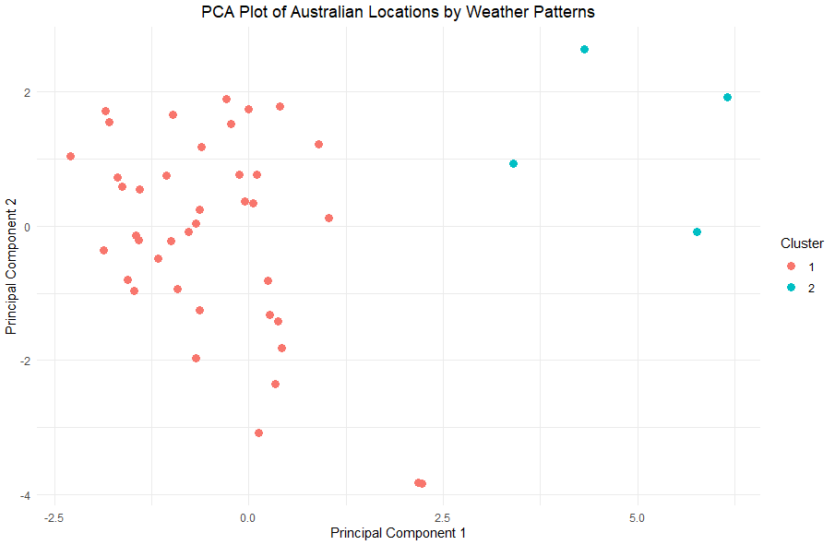
Research Question 3: Which locations in Australia have similar weather patterns?
Identifying climate-based location groups helps the Department plan region-specific water management and drought strategies.
Clustering Overview
8 Standardized Weather Features
Optimal Clusters (Elbow & Silhouette) → k = 2
Cluster Sizes:
Cluster 1 → 40 Locations
Cluster 2 → 4 Locations
PCA Results
Clear separation between two groups along Principal Component 1
Indicates substantial differences in overall weather patterns
Takeaway
Australia’s locations cluster into two main weather pattern groups, with most locations sharing similar conditions and a small group showing distinctly different climate characteristics.

Slide 11
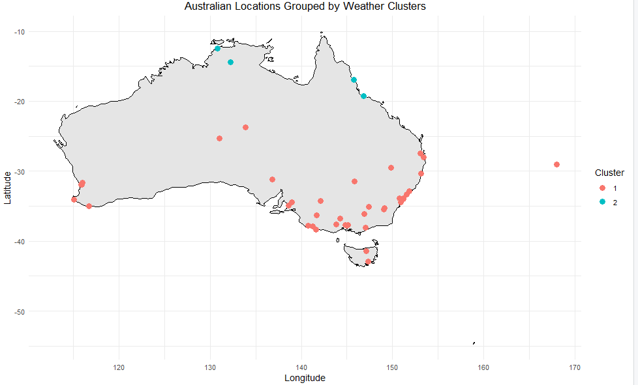
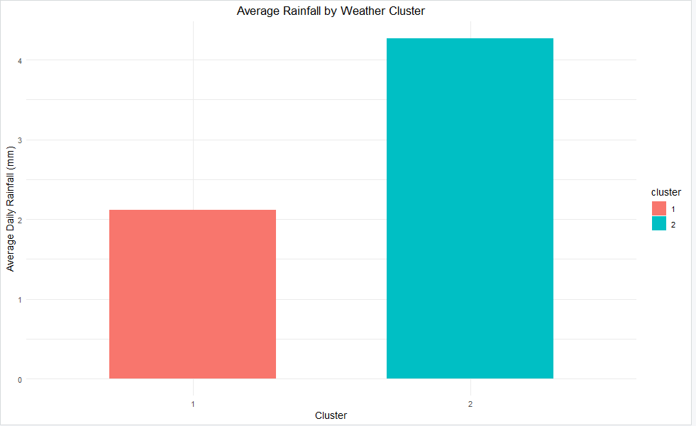
Research Question 3: Which locations in Australia have similar weather patterns?
Geographic Pattern
Cluster 1 → Predominantly Southern & Coastal regions
Cluster 2 → Concentrated in Northern Australia
Rainfall Differences
Cluster 1 → ~2.1 mm average daily rainfall
Cluster 2 → ~4.3 mm average daily rainfall
Cluster 2 receives approximately double the rainfall of Cluster 1
Takeaway
Northern locations form a wetter, distinct climate zone, while most southern locations share a drier weather profile.

Slide 12
Overall Conclusions and Strategic Recommendations
Key Findings (Research Question 1)
High Humidity (9am & 3pm) → More Rain
Low Pressure → More Rain
High Maximum Temperature → Less Rain
Strong Afternoon Temperature & Pressure → Increase Rainfall
Recommendations (Research Question 1)
Monitor humidity and pressure daily to anticipate rainfall events
Track maximum temperature trends to identify early drought conditions
Key Findings (Research Question 2)
Strong Overall Performance → 84.9% accuracy, AUC 0.865
Very Reliable for No Rain → 94.9% specificity
Moderate Rain Detection → 49.2% recall
Pressure (9am ↑, 3pm ↓) → Strongest driver
Wind Gusts & Humidity (3pm) → Increase rain
Higher Maximum Temperature → Decreases rain
Recommendations (Research Question 2)
Monitor morning & afternoon pressure daily
Track wind gusts and afternoon humidity
Key Findings (Research Question 3)
Two Distinct Climate Clusters Identified (k = 2)
Cluster 1 (40 locations) → Lower average rainfall
Cluster 2 (4 locations) → Significantly higher rainfall (~2×)
Clear North-South climatic separation
Recommendations (Research Question 3)
Develop region-specific water management and infrastructure plans using the climate clusters
Prioritize rainfall monitoring in high-rainfall regions and strengthen drought planning in drier regions

Slide 13
References
[1] R Core Team. (2024). R: A language and environment for statistical computing. R Foundation for Statistical Computing. https://cran.r-project.org
[2] RStudio Team. (2024). RStudio: Integrated Development Environment for R [Computer software]. Posit Software, PBC. https://posit.co
[3] Young, J., & Young, A. (n.d.). Rain in Australia [Data set]. Kaggle. https://www.kaggle.com/datasets/jsphyg/weather-dataset-rattle-package

Slide 14

Thank you!

